Slide 1
CI/CD Pipeline and Cloudwatch Dashboards
CETM67 Assignment 2

Slide 2
Agenda
Topic | Speaker
CI/CD to Enable DevOps | Paul Jones
Pipeline Overview | Paul Jones
Discussion of Pipeline | Paul Jones
Cloudwatch and Dashboards | Paul Jones
Justification of Metric and Alarm Choices | Paul Jones
Lessons Learned & Final Thoughts | Paul Jones

Slide 3
CI/CD to Enable DevOps
What is CI/CD and how/why does it enable DevOps

Slide 4
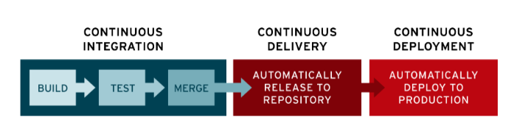
How Does CI/CD Enable DevOps
CI/CD stands for Continuous Integration / Continuous Delivery.
It is the practice of constantly developing, upgrading and enhancing software and deploying it seamlessly. (Redhat, n.d.)
This is predominantly done via automation, using automated tools and technologies to automate the deployment of code.
Continuous Integration revolves around code being automatically tested, analysed and uploaded to a central repository. (Sacolick, 2020)
From there, the code is then deployed through the necessary locations, such as cloud instances or cloud services.
DevOps, as a concept, makes heavy use of this automation to design, develop and deploy applications and solutions for clients.
Rather than writing code and handing it to a different team to test and then a third team to deploy the changes to the live environment, DevOps involves a team completing all tasks cooperatively, without any sort of ‘walls’ or divisions between the different aspects of the systems development lifecycle. Ci/CD allows a DevOps team to complete these actions by performing tests and analysis on code as soon as it is uploaded to a repository and identify any errors or potential problems immediately.
This allows a quick response and quick turnaround to fixing these problems as and when they occur.

Slide 5
CI/CD Pipeline
Using Github Workflows to action a Pipeline

Slide 6

Discussion of Pipeline
WORKFLOWS
GitHub equivalent of pipelines used for CI/CD (Github, n.d.)
Functionally the same as any other tool (Jenkins etc.)
A Workflow consists of the following:
1) A YAML File
2) A series of Actions
3) Triggers for the Workflow
YAML
A Human-readable language used for data serialisation and configuration files for applications (Wikipedia, 2021)
A subset of JSON (RedHat, 2021) that uses Python indentation to show nesting.
Usable with almost any application as YAML is made up with elements from many different languages (C, PERL, HTML et. Al.) (RedHat, 2021)
YAML (Yet Another Markup Language) provides the steps that are executed on the workflow
These steps include what to run, what to do if it errors, what container-type to use etc.
Very easy to read and write YAML files as it uses English for most tasks (Chaudhari, n.d.)
Easy to understand other YAML files due to simplicity of the language (Chaudhari, n.d.)
Indentation can be tricky – even a single space missed can stop code working (Chaudhari, n.d.)
XML and JSON are more widely accepted and used by currently built applications (Chaudhari, n.d.)
GITHUB ACTIONS
Individual tasks that can be performed on a GitHub Repository (Mulonda, 2020)
Combined together, these actions create jobs and enable workflow customisation
Actions are designed and created by GitHub, or, by the community (Github, n.d.)
Very customisable – you can write your own actions if needs be (Github, n.d.)
Must be familiar and use YAML to create said actions.
Jobs are self-contained, each job runs on its own container. (Github, n.d.)
ASSIGNMENT 2 PIPELINE
2 Separate Jobs.
Job 1 – Code Analysis to determine if code is safe and good quality **VERY IMPORTANT**
Ran first due to Lambda being deployed on the Cloud – potential cost implications if not fully tested.
Job 2 – Package up the Lambda Function to a Zip file and upload it to a pre-determined S3 Bucket for final evaluation and deployment.
Ran second after code has been determined to be suitable

Slide 7
Pipeline Overview – Job 1: Function Analysis
Start
A
B
C
D
Requirements Text File?
Errors?
Security check with Safety
Yes
Install Required Dependencies
Yes
If any of the Linting et. Al. steps return errors, the deployment will fail with an error.
Linting is run on both the Unit test and Lambda function python files.
Bandit is run on the Lambda function only.
Safety is run on all python files.
2 different static code analysers used – both check for different errors. Gives more assurance doe is good quality.
No
No
Errors?
Lint with Pylint
Yes
Install Default Dependencies
No
Errors?
Unit Test the Function
Update default Dependencies
Yes
No
Errors?
Package Check with Bandit
Errors?
Yes
Yes
Errors?
No
No
Yes
Move onto next Job
Fail with Errors
Lint with Flake8
No
A
B
C
D
End

Slide 8
Pipeline Overview – Job 2: Package and Push File to S3
Start
List all files in Workspace
This job is a series of steps to organise and show the files.
AWS access and bucket names are provided via GitHub Secrets
Both jobs use Ubuntu-latest as the default container operating system.
Make artifacts directory
Create the zip file from the Lambda Function
Move the Zip file into the artifacts folder
List the files in the directory
Push the Zip file to the S3 bucket
End

Slide 9
Cloudwatch
Using Cloudwatch to Monitor Metrics and Alarms

Slide 10
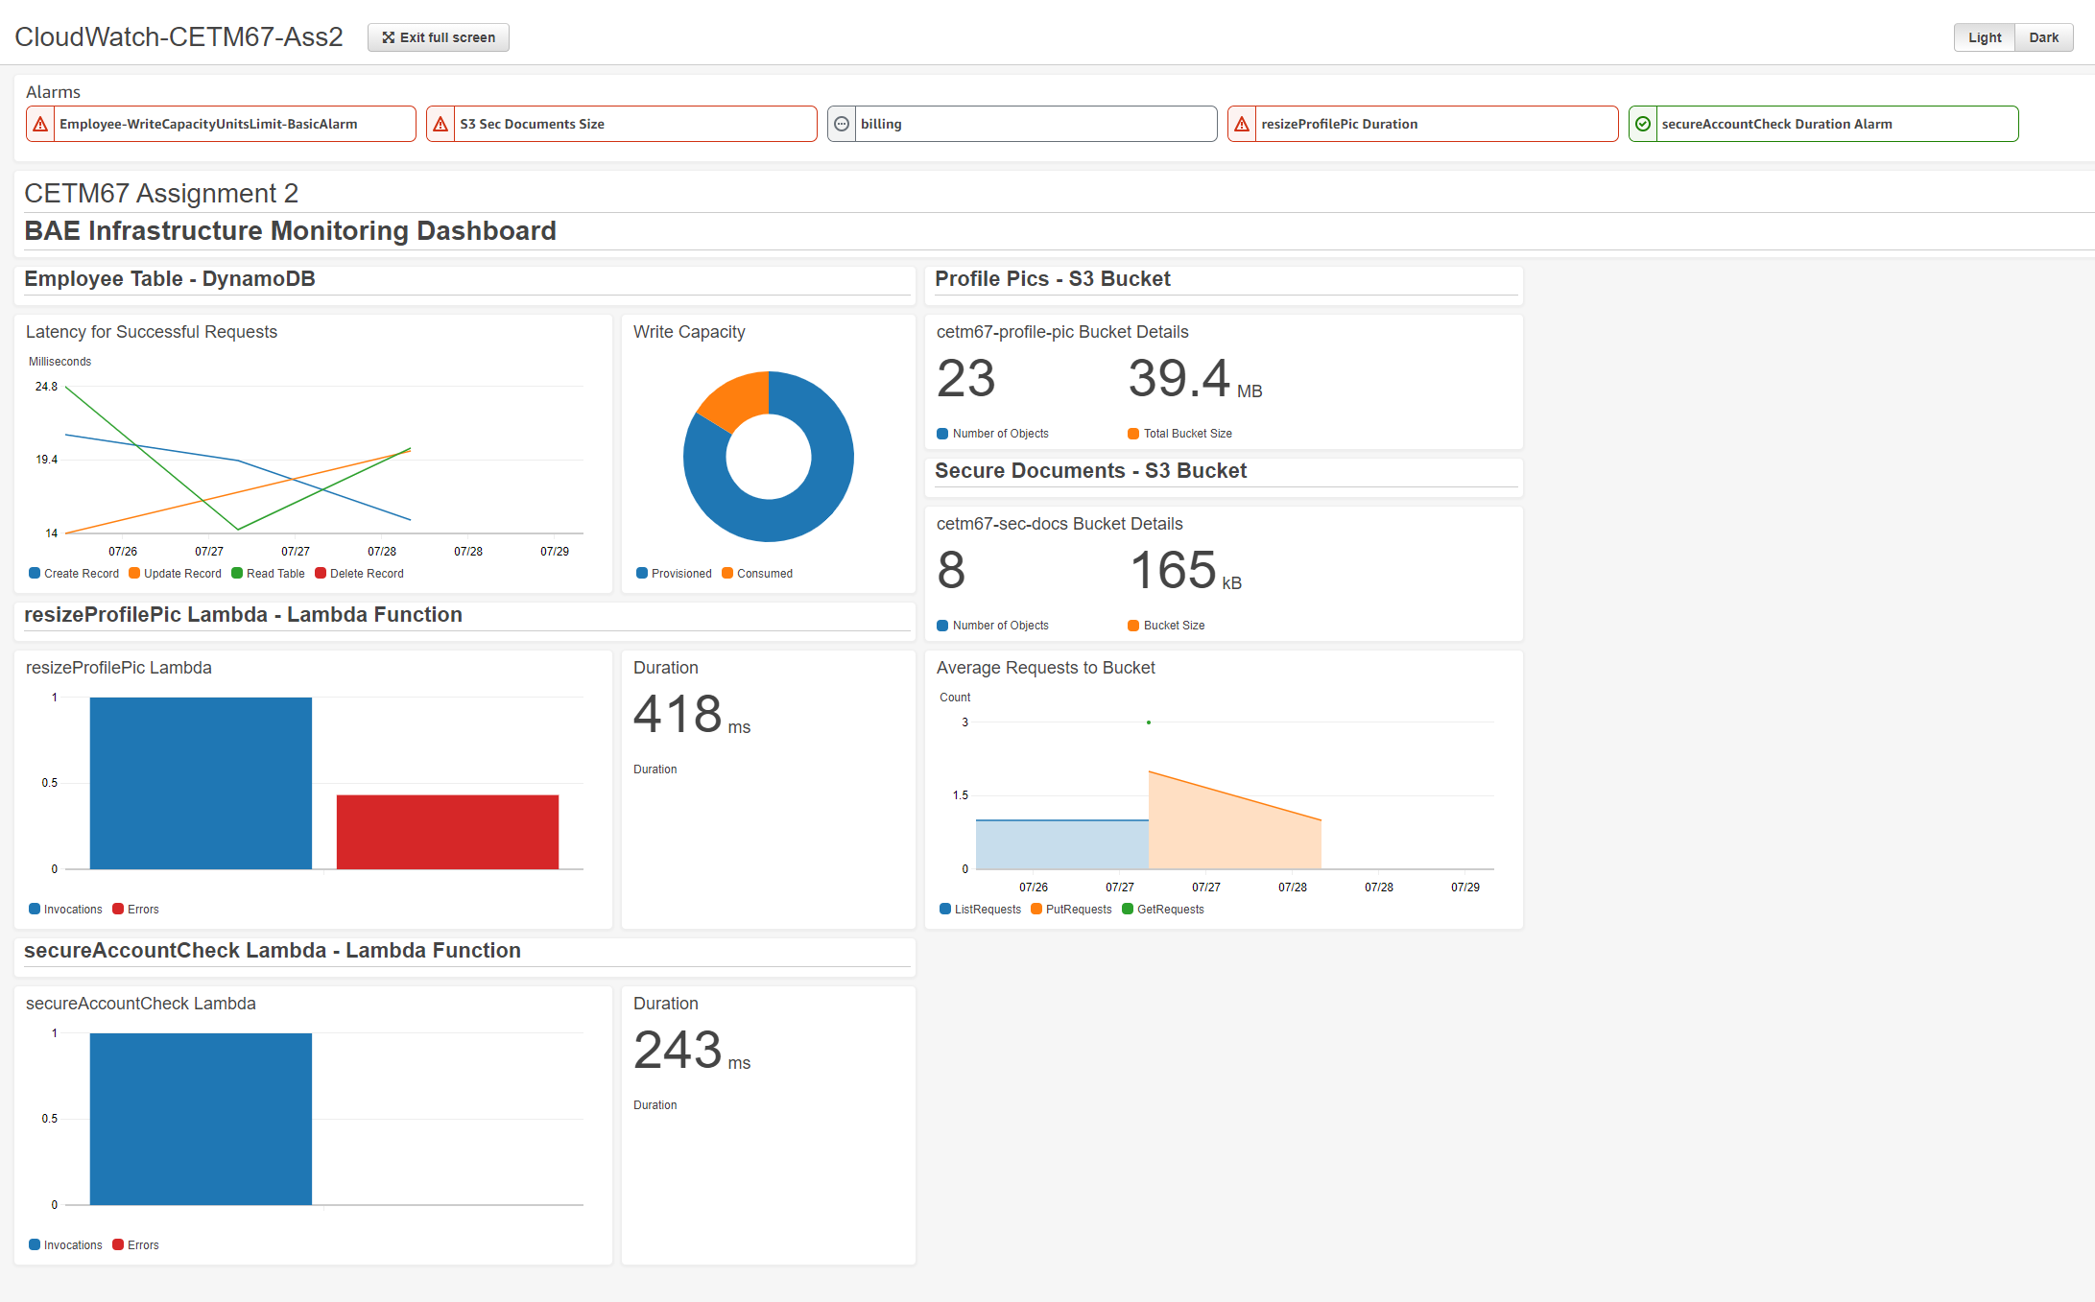
Metric Choices
Metrics have been decided upon based on estimated use-cases for the VPC Infrastructure.
Primarily, based around costs, i.e. Write Capacity monitoring to help work out if reserved Dynamo DB or normal Dynamo DB plans should be used.
Latency is also a key statistic for monitoring the DynamoDB, high latency could indicate a problem with the database or connections.
Lambda Monitoring revolves around the observation of number of invocations and any failed invocations that resulted in errors.
Again, potentially indicates the amount of use, to monitor for pricing thresholds or potential problems.

Slide 11
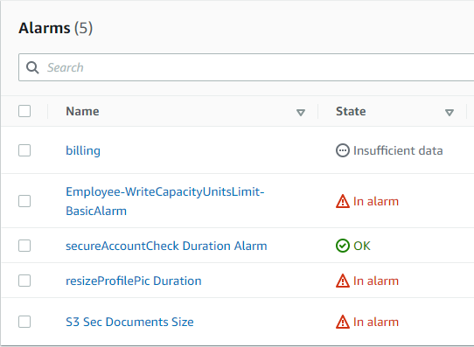
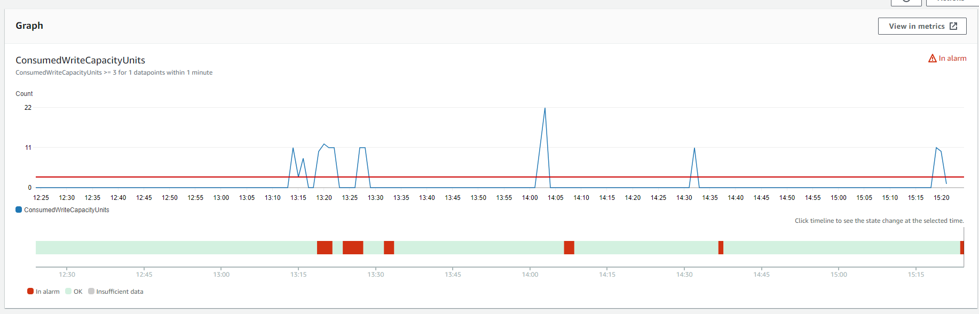
Alarm Choices
4 main alarms chosen, each around a key area of the application infrastructure. Plus an additional billing alarm to alert for billing outside the norm ($0 in this infrastructure)
The first alarm deals with the write capacity of the DynamoDB. If this triggers it means that there is close to too much being written to the database for the currently paid for capacity and that this is in danger of adding costs to the AWS services. This can be used to identify if there are times of high usage, meaning that planned reserved instances can be scheduled.
Alarm 2 deals with the S3 bucket. Whilst a Bucket can hold up to 5 Terabytes of data, the security documents are only ~50kb large, if there is ever over 100Mb of data uploaded into the S3 bucket it should be investigated to ensure that incorrect files are being uploaded.
The third alarm revolves around the duration of the resizeProfilePic Lambda function. This function resizes a profile picture to a 100 x 100 pixel image. The process should take no longer than 3 seconds, if it takes any longer then there has been an error, Lambda Functions cannot handle files larger than 6mb in one go. If the function takes longer than 6 seconds to respond an unexpected error has occurred and should be investigated.
The final alarm checks the duration of the secureAccountCheck Lambda function. Again, the function is relatively straightforward and, because it only deals with Boolean and Integer variables, it should execute in under 1 second, if it does not than there has been an issue with the data uploaded to Dynamo or some other error and this should be investigated fully.
The billing alarm will alert the Admin Team to any additional costs, this can then be investigated to determine what steps can be taken to reduce or remove the costs.

Slide 12
Lessons Learned

Slide 13
Lessons Learned
Container O/S Images used by Workflows can use out of date Python Libraries – which can cause triggers for Bandit, Safety code analysis packages etc.
The different jobs on workflows are independent of one another, each use a new, unique container. Folder structures created in workflows are ephermal and cannot be accessed by a later workflow.
Workflows are very powerful, there are thousands of custom actions written by GitHub community members available for use.
Care must be taken when using these, always need to ensure they do not do anything untoward or dangerous.
It is not good enough to measure every metric for the sake of it, care must be taken to select metrics that are suitable to monitor.
The same is true for alarms.
Unit Testing functions that themselves require access to other AWS services creates a lot of problems for Unit Testing. The Mock python library can support with this but vastly increases the complexity of the Unit Testing scripts.
S3 Metrics do not, by default, send any more frequently than every few days to Cloudwatch. In order to counter this, custom lambda functions can be written to gather metrics and store them in logs.

Slide 14
References
Chaudhari, A., n.d. CSEStack.org. [Online] Available at: https://www.csestack.org/advantages-disadvantages-yaml/ [Accessed 20 07 2021].
Erik, 2018. Cloudbees.com. [Online] Available at: https://www.cloudbees.com/blog/yaml-tutorial-everything-you-need-get-started [Accessed 11 07 2021].
Gibb, R., 2019. StackPath.com. [Online] Available at: https://blog.stackpath.com/yaml/ [Accessed 05 07 2021].
Github, n.d. docs.GitHub.com. [Online] Available at: https://docs.github.com/en/actions/creating-actions/about-actions [Accessed 05 07 2021].
Github, n.d. GitHub.com. [Online] Available at: https://github.com/features/actions [Accessed 11 07 2021].
Labithiotis, 2019. stackoverflow.com. [Online] Available at: https://stackoverflow.com/questions/57498605/github-actions-share-workspace-artifacts-between-jobs [Accessed 20 07 2021].
Mulonda, Y., 2020. Bits and pieces. [Online] Available at: https://blog.bitsrc.io/what-are-github-actions-and-how-to-use-them-e89904201a41 [Accessed 05 07 2021].
RedHat, 2021. Redhat.com. [Online] Available at: https://www.redhat.com/en/topics/automation/what-is-yaml [Accessed 05 07 2021].
Redhat, n.d. Redhat.com. [Online] Available at: https://www.redhat.com/en/topics/devops/what-is-ci-cd [Accessed 22 07 2021].
Tanner, G., n.d. Gabrieltanner.org. [Online] Available at: https://gabrieltanner.org/blog/an-introduction-to-github-actions [Accessed 05 07 2021].
Wikipedia, 2021. Wikipedia.org. [Online] Available at: https://en.wikipedia.org/wiki/YAML [Accessed 05 07 2021].

